Slide 1

C: Flowcharts, Algorithms and Problem Solving
BY Karthik subramanian

Slide 2
Lucidchart
Lucidchart is a UML diagram creation tool for creating flowcharts and other UML diagrams.
UML - Unified Modelling Language to help visualize and understand code flow.
Flowchart is a descriptive step by step flow of how the program is to be designed for a particular problem scenario.

Slide 3
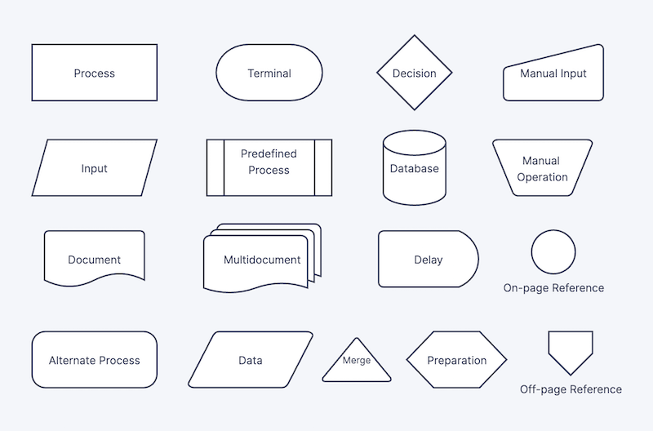
Flowchart symbols

Slide 4
Lucidchart
The freeware version allows users to create/edit only 3 documents per day.
You can easily create a flowchart for your programming problem with all the desired flow scenario, shapes, color fill and export it as a multipage or single page link/document of type pdf/jpeg/png.

Slide 5
Algorithmic Thinking and Pseudocode
Algorithmic thinking is the process of creating the steps needed to solve a particular problem.
When we are presented with a particular problem statement, we need algorithmic thinking to use what is provided as an input and have a step by step procedure for converting it into the solution.
Pseudocode analysis is creating the description of the steps in the algorithm in pseudocode format which is nothing but simple coding steps like, compute, input, check etc. which is not any high level language but program like instructions.

Slide 6
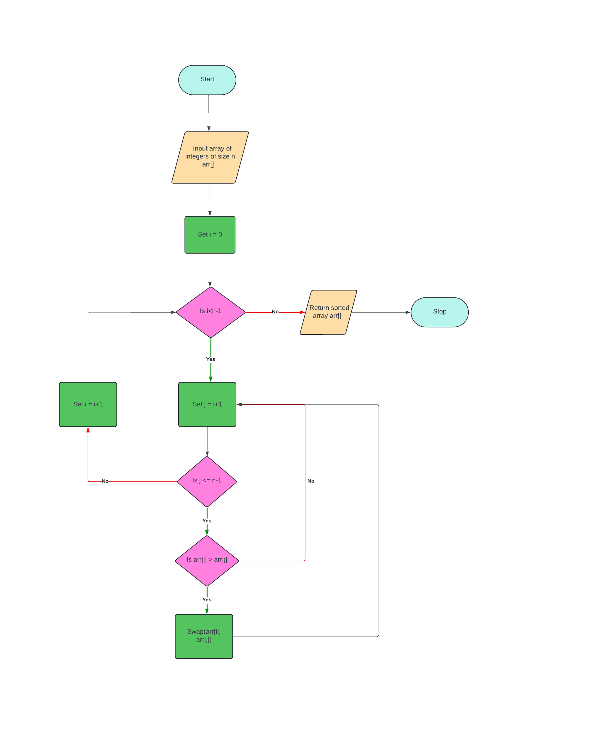
Lucidchart- flowchart for Bubble Sort

Slide 7
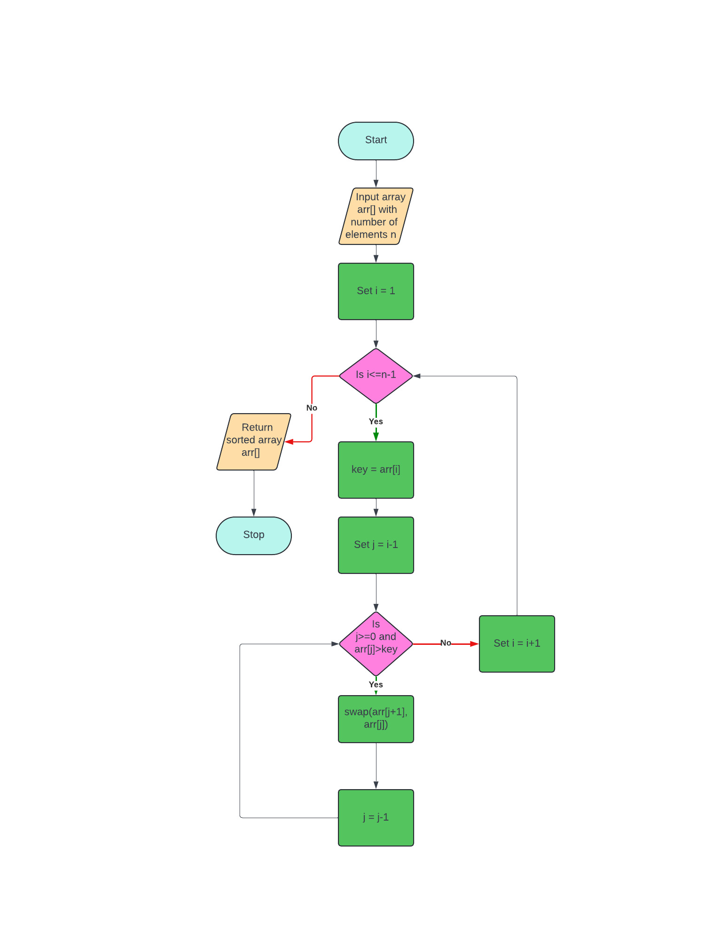
Lucidchart- flowchart for Insertion Sort

Slide 8
Designing flowcharts for sorting algorithms
Start with a start symbol
Input the array of size N (mention the indexing - 0..N-1 or 1 to N)
How many loops are required for the sort (2 for bubble/insertion/selection and 1 for quick/merge) ?
What is the direction of the loop counter of the outer loop?
What will you check inside the inner loop based on values from the outer loop?
Give instructions for swap based on condition for value comparison.
Increment loop counters
When all loop counters finish, output the sorted array.

Slide 9
Algorithmic Problem Solving
Algorithmic problem solving is the technique of creating or formulation of an algorithm to solve a particular problem statement.
This requires the following criteria to completely create the algorithm:
Understanding the problem
Ascertaining the capabilities of the computational device
Choosing between exact and approximate problem solving
Deciding a data structure
Calculating the complexity of the algorithm and optimizing it to make it efficient.

Slide 10
Algorithmic Problem Solving- Understanding the problem
Understanding the problem
What inputs are provided to the user? (E.g., array of int, size)
How many inputs are provided? (E.g., 2,3,.. etc.)
The inputs are provided in what format? (dynamic array, static array, int pointer etc.)
At the end of this step, we need to make sure we have:
Exactly, the set of inputs that the algorithm handles.
The correct algorithm that will work for all possible values and use cases of legitimate inputs.

Slide 11
Algorithmic Problem Solving- Ascertaining the capabilities of the computational device
What memory constraints does the device support?
What is the scalability factor of the data (low, medium, large, very large) as this will influence the complexity of the algorithm and the efficiency in speed and throughput?
Does it support only sequential or even concurrent/parallel processing?

Slide 12
Algorithmic Problem Solving: Choosing between exact and approximation algorithm
It is the programmer’s choice whether you want to solve the problem approximately (approximation algorithm) or exactly (exact algorithm).

Slide 13
Deciding a data structure
Data structure plays a vital role in the design and analysis of algorithms.
Some of the algorithm design techniques also depend on the way the data is structured as this has a crucial role to play in the program’s instance.
At the end of the program is nothing but a combination of data structures and algorithms
PROGRAM = DATA STRUCTURES + ALGORITHMS

Slide 14
Algorithm Design Techniques
An algorithm design technique is a strategy or paradigm for solving generic programming use cases that can be applicable for solving problems in many areas of computing.
Learning algorithms is important because:
They provide guidance for solving algorithms for newer problems.
They are an important asset and cornerstone of computer science.

Slide 15
Examples of some algorithms used in the industry today
Merge sort, quick sort, bit algorithms, binary search, hashing, recursion etc. in web development
Linear regression, KNN (k nearest neighbors), supervised learning, reinforcement learning in AI (artificial intelligence)
Path finding (Djstrak’s), collision detection, physics engine for simulating real world objects in VR or virtual reality / 3D gaming.

Slide 16
Implementing search algorithms- linear search
void linearSearch(int arr[], int size, int key)
{
printf("\n Linear Search \n");
for(int i =0;i<size;i++)
{
if(arr[i]==key)
{
printf("\n Key %d found at position %d ", key, i+1);
return;
}
}
printf("\n Key %d not found! ", key);
return;
}

Slide 17
Implementing search algorithms - binary search
void binarySearch(int arr[], int size, int key )
{
int low, high, mid;
printf("\n Binary Search \n");
for(low = 0, high = size-1 ; low<=high;)
{
mid = (low+high)/2;
if(arr[mid]==key)
{
printf("\n Key %d found at position %d ", key, mid+1);
return;
}
else if(arr[mid]<key)
{
low = mid+1;
}
else
{
high = mid-1;
}
}
printf("\n Key %d not found! ", key);
return;
}

Slide 18
Writing and Visualizing Search Algorithm
When writing or visualizing any search algorithm, we need to identify how do we search for a key element in an input array.
For linear search:
If it is unsorted, iterate over all the elements starting from the first sequentially until a match is found.
For binary search:
Compare the key with the midpoint of the sorted array
If the midpoint matches the key, return the midpoint as the index
Otherwise continue searching for the key in the
right side of the midpoint (when key is more than midpoint), or
left side of the midpoint (when key is less than midpoint)
If no array elements are left, then key doesn’t exist.

Slide 19
Advanced Algorithms and Efficiency
Algorithm efficiency is important in deciding the complexity in terms of time and space.
How efficient is it in time and space constraints in solving the problem ?
The search algorithms we saw earlier - Bubble Sort, Insertion Sort and Heap Sort are all having two nested loops based on the input value. Therefore the complexity is O(n²)
There are more advanced algorithms (some have been mentioned earlier) that take up less computational complexity in terms of time. These are:
Quick Sort
Merge Sort
Both follow a divide and conquer based approach which reduces the complexity due to two nested loops to average O(n log (n)) complexity.

Slide 20
Exploring recursive algorithms
Recursive algorithms are those where the function calls itself iteratively until a particular condition is met.
Examples are : Fibonacci series and Factorial calculation
For instance when we compute Fibonacci series, we start with 1 and 1 and then the next values are basically sum of previous two indices
In such a case, if we pass N as an input to the function, it is called N times.
For instance, if there are 2 lines of code, for an input value N, it is called 2^{N} times or O(2^{N}) which makes it computationally restrictive for large values of N
Even factorial calculation take up O(2^{N}) complexity as we need to recursively call the same function

Slide 21
Fibonacci series: algorithm
Fibonacci(N)
Input N
If N = 1, return 1
Else If N = 2, return 1
Else return Fibonacci(n-1) +Fibonacci(n-2)

Slide 22
Factorial Calculation
Factorial(N)
Input N
If N = 1 return 1
Else return N * Factorial(N-1)

Slide 23
Introduction to Efficiency: Understanding Big O Notation
“Big O notation is a mathematical notation that describes the limiting behavior of a function when the argument tends towards a particular value or infinity.
It is a member of a family of notations invented by Paul Bachmann, Edmund Landau, and others, collectively called Bachmann–Landau notation or asymptotic notation.”

Slide 24
Understanding Big O notation
In plain words, Big O notation describes the complexity of your code using algebraic terms.
To understand what Big O notation is, we can take a look at a typical example, O(n²), which is usually pronounced “Big O squared”. The letter “n” here represents the input size, and the function “g(n) = n²” inside the “O()” gives us an idea of how complex the algorithm is with respect to the input size.

Slide 25
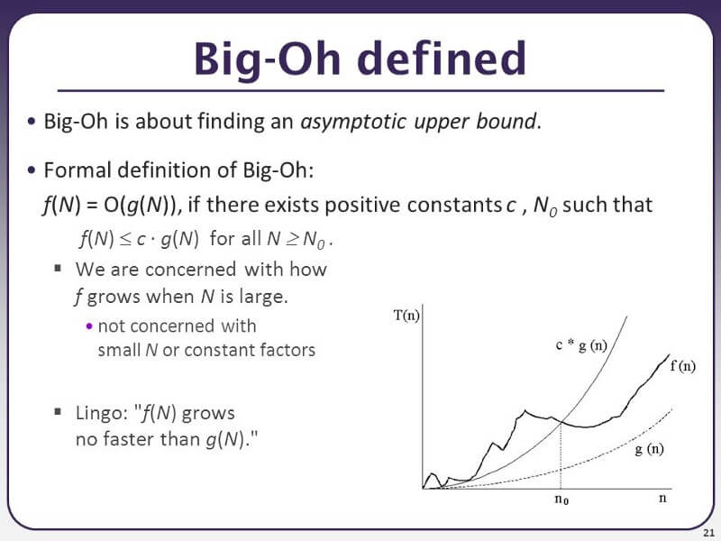
Big Oh mathematically

Slide 26
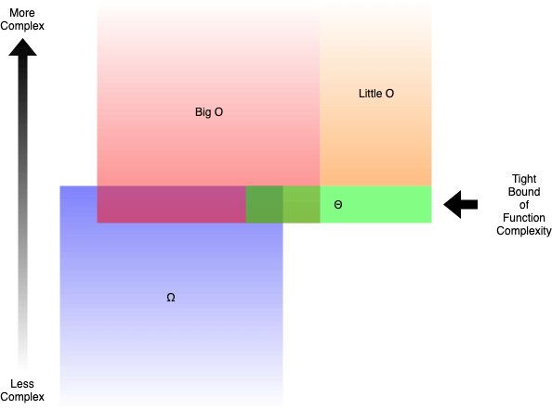
The various programming bounds
In plain words:
Big O (O()) describes the upper bound of the complexity.
Omega (Ω()) describes the lower bound of the complexity.
Theta (Θ()) describes the exact bound of the complexity.
Little O (o()) describes the upper bound excluding the exact bound.

Slide 27
Understanding of Big O complexity for linear search
void linearSearch(int arr[], int size, int key)
{
printf("\n Linear Search \n");
for(int i =0;i<size;i++)
{
if(arr[i]==key)
{
printf("\n Key %d found at position %d ", key, i+1);
return;
}
}
printf("\n Key %d not found! ", key);
return;
}
The complexity of this code is n-1 or O(n)
n - 1

Slide 28
Understanding of Big O complexity for selection sort
void selectionSort(int arr[], int n)
{
int smallIdx =0;
for(int j, i = 0; i<n-1;i++)
{
smallIdx = i;
for(j = i+1; j<n;j++)
if(arr[smallIdx]>arr[j])
smallIdx = j;
swap(&arr[i], &arr[smallIdx]);
}
}
Thus, the overall complexity of selection sort algorithm is (n-2)*(n-2) which is n(n-1)/2 or O(n²)
n-2
n -2

Slide 29
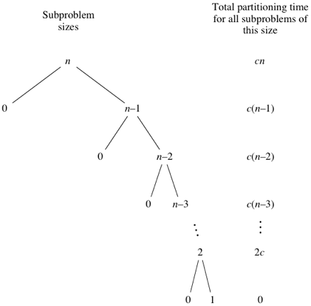
Understanding complexity of quicksort : Worst Case
cn + c(n-1) + c(n-2) + c(n-3)+ … 2c = c(n + (n-1) + (n-2) + (n-3)…)
= c(n+1)(n/2) +1 = O(n²)

Slide 30
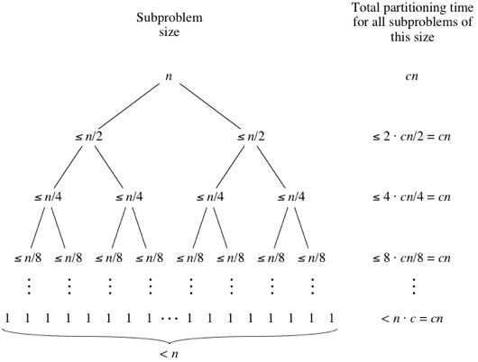
Understanding complexity of quicksort: Best Case
The best case for quicksort is O(n(log₂(n))

Slide 31
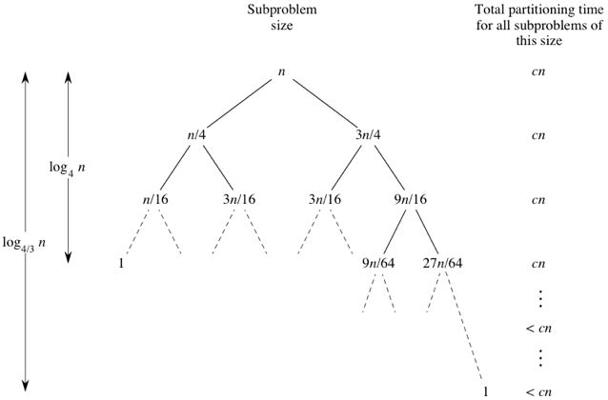
Understanding complexity of quicksort
The average complexity is O(n(log₂n))

Slide 32
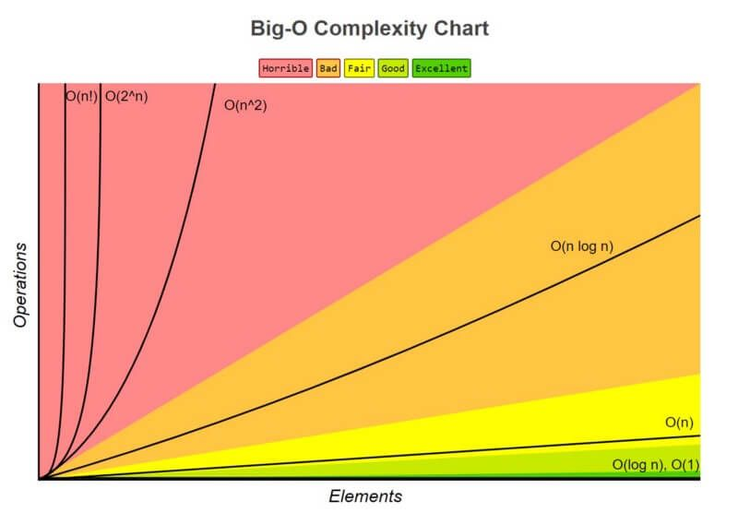
Understanding of the different Big O complexity correlation

